Slide 1
CSE 2102: Introduction to Software Engineering
Software Production Process
Process Models

Slide 2
Waterfall models
Invented in the late 1950s for large air defense systems, popularized in the 1970s
Organize the activities in the development of a software product in a linear, sequential flow.
Output (“deliverables”) of one stage is input to the next stage.
Exists in many variations, all sharing the sequential flow style.

Slide 3
Waterfall models (contd..)
Feasibility study
Requirements
Design
Coding and module testing
Integration and system testing
Delivery, deployment, and
maintenance

Slide 4
Waterfall models (contd..)
Organizations adopting them standardize the outputs of the various phases (deliverables)
May also prescribe methods to follow in each phase
  Organization of methods in frameworks often called methodology
Example: Military Standard (MIL-STD-2167)
Standardization allows:
  Accurate measurement of project progress
  Measurement of internal quality

Slide 5
Evaluation of the waterfall model
Contributions to the understanding of software process:
  Software development process must be disciplined, planned and managed.
  Implementation should be postponed until after the objectives are clearly understood.
Characteristics of a strict waterfall model:
  Linear: Process progresses from beginning to the end without backtracking.
  Rigidity: Results of each phase are final and complete before proceeding to the next phase.
  Monolithic: All planning is oriented towards a single delivery date.

Slide 6
Waterfall model with feedback
Feasibility study
Requirements
Design
Coding and module testing
Integration and system testing
Delivery, deployment, and
maintenance

Slide 7
Evolutionary models
Brooks advocates building a product twice:
  First version of the product is a trial: throwaway prototype.
  Used to provide feedback on exact requirements.
  Second version developed using the waterfall model.
  Doesn’t eliminate the time gap between requirement definition and product delivery.
Evolutionary or incremental approach:
  Stepwise development.
  Flexible and non-monolithic.
  Parts of some stages postponed.
Evolutionary model has several different versions

Slide 8
Evolutionary models (contd..)
Evolutionary process model (Boehm):
  Model whose stages consist of expanding increments of an operational software product, with the direction of evolution being determined by operational experience.
Delivered increment:
  Self-contained functional unit that provides useful purpose to the customer.
  Includes supporting material (documentation, training material, etc.)
Development strategy (Glib, 1988):
  Deliver something to the real user.
  Measure the added value to the user in all critical dimensions.
  Adjust design and objectives accordingly.
Must use waterfall process discipline.

Slide 9
Evolutionary models (contd..)
Incremental implementation model: Waterfall model used until the implementation phase.
  Implementation done incrementally.
  Requirements analysis and design emphasis on useful, deliverable subsets and flexible interfaces.
  Different plans are implemented, tested and delivered at different times.
  Incremental implementation is only a partial solution.

Slide 10
Evolutionary models (contd..)
Incremental development and delivery model: Incremental approach expanded to all stages of life cycle.
  Achieves finer granularity in the process.
  Waterfall model is followed for different portions.
  Increments developed after feedback received from the user.
  Allows users to understand what they actually need leading to changes in requirements.

Slide 11
Evolutionary models (contd..)
Evolutionary prototype: Prototype is aggressively transformed into the final application.
Prototyping helps designer understand user requirements.
Prototyping and evolutionary techniques may require supporting tools.
Evolutionary models incorporate maintenance into every stage of the model.
  Supports ease of modification.

Slide 12
Evaluation of evolutionary models
Problems with evolutionary models:
  Emphasis on user interface rather than product/process.
  Requires tools to manage complexity.
Advantages to evolutionary models:
  Product may more closely follow user requirements.
  Supports the anticipation of changes.
  More flexible approach than waterfall.

Slide 13
Transformation model
Transformation model has roots in formal specifications.
Views software development as a sequence of steps that transform a specification into an implementation:
  Internal requirements analyzed and formally specified.
  Formal specification is transformed into more detailed, less abstract formal description.
  Repeat the above step until description is executable by some abstract processor.
  Further transformations may be need to increase efficiency.
Transformation may be done manually or by a software engineer.
  Transform a recursive into a non-recursive implementation.
Still a theoretical reference model.

Slide 14
Transformation model (contd..)
Two main stages:
  Requirements analysis:
    Provides formal requirements.
  Optimization:
    Requirements fed into optimizer for performance tuning.
Transformation controlled by software engineering
  Takes advantage of reusable components.
Before transformation, specifications are verified against user expectations.
Transformation model supported by software development environment. Tools for:
  Verifying requirements
  Handling reusable components
  Performing optimization
  Storing development history.

Slide 15
Transformation model (contd..)
Major advantage over waterfall model:
  Allows changes to be made at any transformation step as user requirements are defined.
Problems:
  Not a practical paradigm.
  Only supported in experimental environments.
  Works well for small problems only.
  Harder for software engineers to use.
Transformation model has been studied for small programs as a way of proving correctness.
  A constructive, mathematically-based approach.

Slide 16
Spiral model
Purpose: Provide a framework for designing production process guided by risk levels.
Metamodel: Model that accommodates any process development model.
Guiding principles: Levels of risk.
Risk: Potentially adverse circumstance.
Risk management (Boehm):
  Discipline whose objectives are to identify, address and eliminate software risk items before they become either threats to successful software operation or a major source of expensive software rework.

Slide 17
Spiral model (contd..)
Focuses on identifying and eliminating high-risk problems by careful process design.
Cyclic model with four stages:
  Stage 1: Identifies objectives and design alternatives.
  Stage 2: Evaluate alternatives and identify/deal with potential risks.
  Stage 3: Develop and verify next level product.
  Stage 4: Review results and plan for next iteration.
Allows unstated requirements to become part of next specification cycle:
  Robustness approximates correctness more closely.

Slide 18
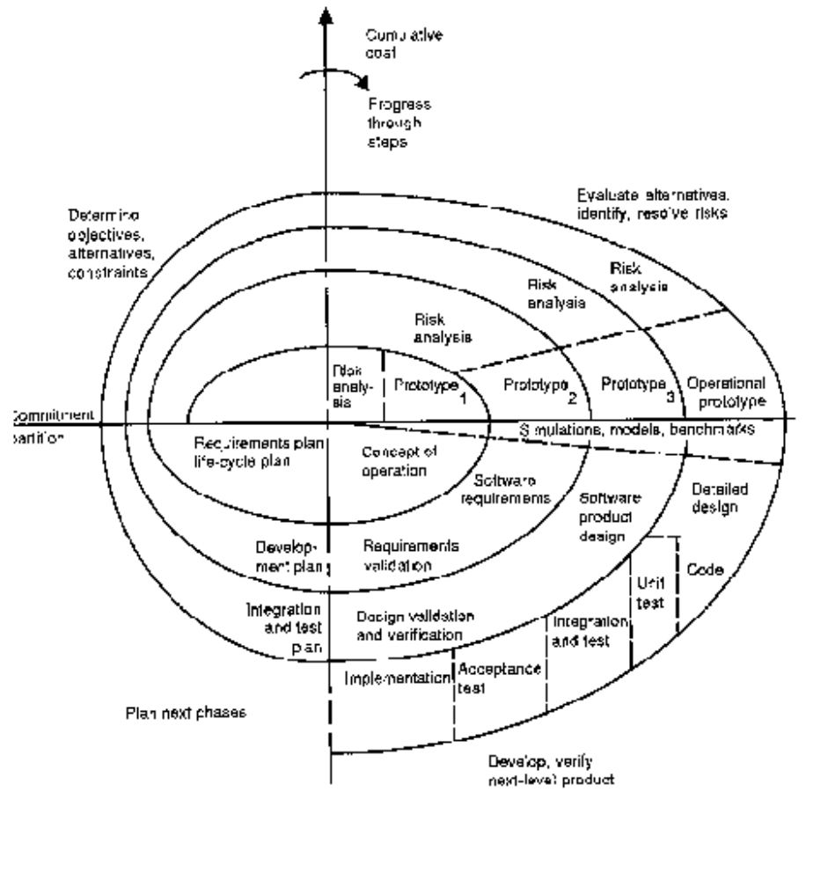
Spiral model (contd..)

Slide 19
Defining Characteristics of Models
Waterfall:
  Rigid, Inflexible, Linear.
Evolutionary:
  Increment-driven.
Transformation:
  Specification-driven.
Spiral:
  Risk-driven

Slide 20
Software evolution: Legacy software
Existing software must evolve because requirements change
Re-engineering
  Process through which an existing system undergoes an alteration, to be reconstituted in a new form
Reverse engineering
  From an existing system to its documentation, which may not exist, or may be incomplete
  Includes program understanding
  Preventive maintenance

